Slide 1
Diagnostics Data
Presented by: Shanthosh Reddy Gollapalli Raghunatha
Last Updated: 11/9/2023

Slide 2
Table of contents
Objective
Collecting Data
Data Cleaning
Data Analysis
Data Visualizations
Conclusion

Slide 3
Objective
The purpose of this analysis is to identify and understand the diagnostic data of a mechanical system in the year 2022. The analysis will examine the results and provide recommendations on resolving the issues.

Slide 4
Collecting DATA

Slide 5
Gather and Review Data
Two datasets; Users data and Diagnostics Data
Users Dataset had information about geographic location, unique id and name of the user
Diagnostic Dataset had information diagnostic tests, type of issue and date on which tests were performed
User ID was the common column between two data sets, it was unique and had non null values

Slide 6
Data cleaning

Slide 7
Steps performed to clean up data
Handled records with “Unknown” values
Standardized country and state names. For example, changed USA to United States, IA to Iowa, MI to Michigan
Changed full words to abbreviation. For example, Changed Apartment to Apt
Converted data type of Air Temp, Fuel, Moisture Pct to Numbers
Removed rows with 4-digit zip code
Documented all the changes that I made

Slide 8
Data Analysis

Slide 9
Analysis
Understanding each column header and it’s values
finding relationships between columns
Descriptive analysis on both data sets, like calculating the frequency counts, average values
Tableau visualizations for further analysis

Slide 10
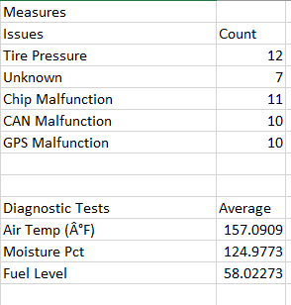
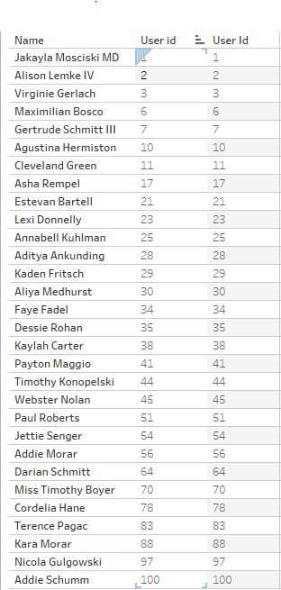
these two image shows the data analysis of the diagnostic data
Left Image has two tables, one calculates the count of each diagnostic issue, and the other table calculates Average value of each Diagnostic tests
Right Image, joins the two tables displays the Name of Users that having their User ID matching in the Diagnostic Data
other comparisons were also performed and generated as visualizations

Slide 11
Data Visualizations

Slide 12
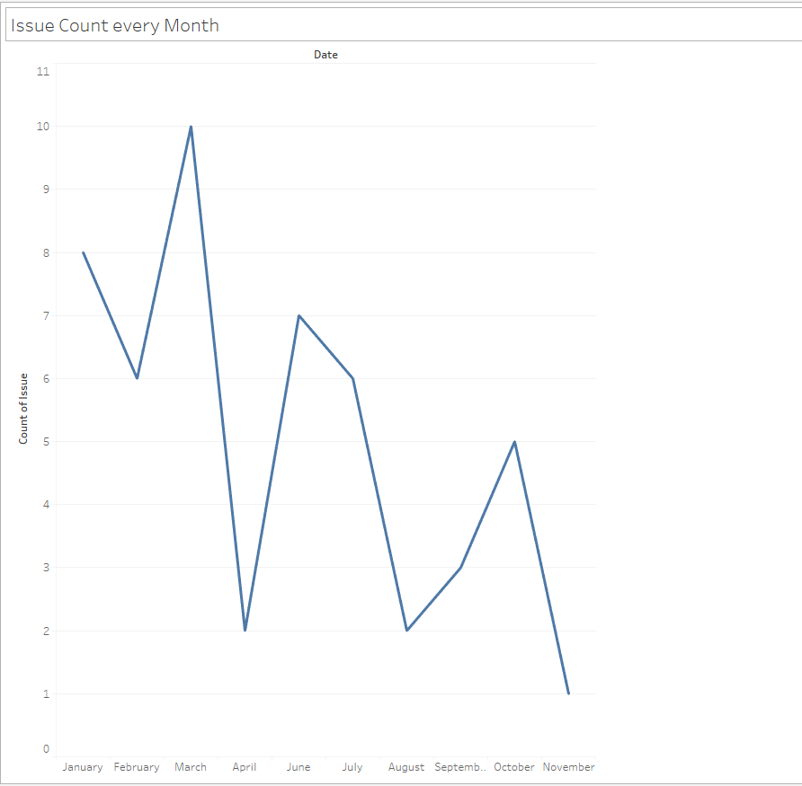
Number of Diagnostic issues occurring every month
The plot shows the trend of the number of issues reported every month, from January to November.
The plot indicates that there is a seasonal pattern in the number of issues reported, with more issues reported in the first half of the year than in the second half of the year.
The plot reveals that there is a significant drop in the number of issues reported from March to April, and from October to November. This may indicate something positive has happened
The plot indicates that Highest number of issues in March and lowest in November

Slide 13
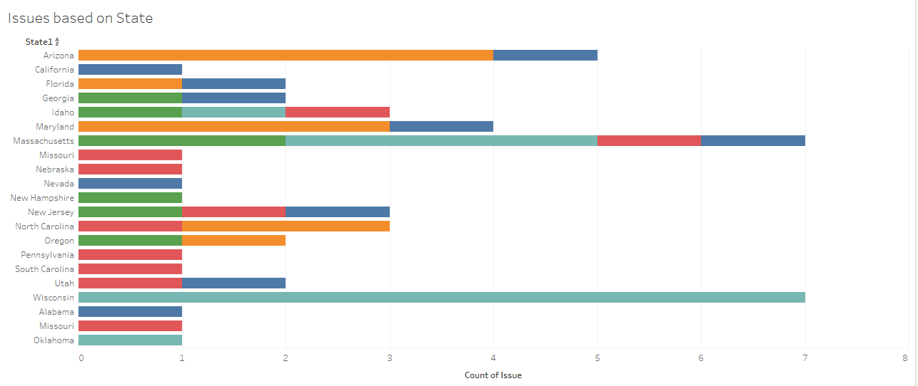
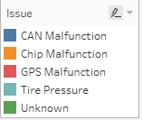
Diagnostic issues based on state
The plot reveals that the most frequent type of issue is “CAN Malfunction”, which affects almost every state. This may indicate some problems or challenges related to CAN Communication
The plot explains that the only diagnostic issue occurring in Wisconsin is “Tire pressure”, this may indicate that it can be related to weather in Wisconsin, very humid in summer and very cold in winter
Most number of issues are reported in Wisconsin and Massachusetts, this could also mean that there are more no of users

Slide 14
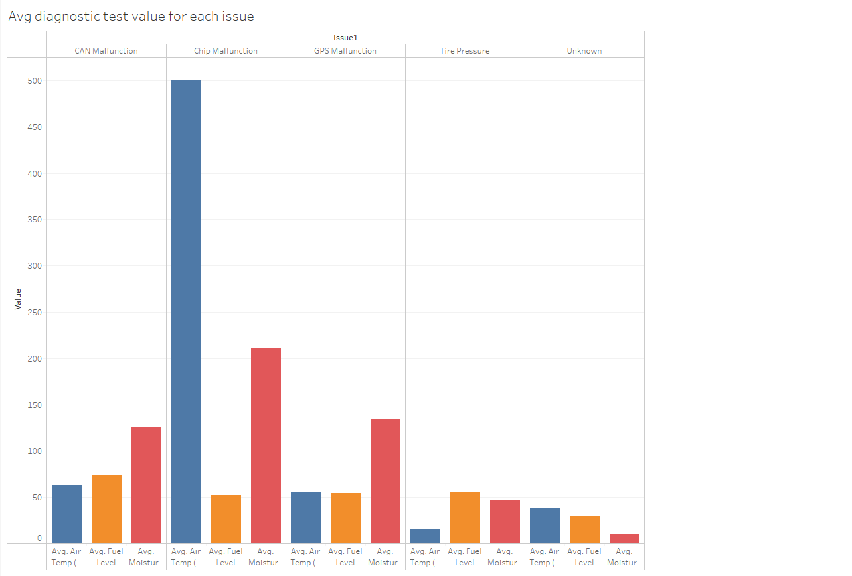

Average Values of Diagnostic Test results based on Diagnostic Issue
The plot reveals that Chip Malfunction Diagnostic issue has the highest average Air Temp. This may indicate that this issues might be critical.
The plot reveals that Avg Moisture Pct value is also high when the diagnostic issue is Chip Malfunction, it is possible that when Moisture pct and Air Temp are high then it is most likely a Chip Malfunction issue

Slide 15
CONCLUSION
Based on the Data Analysis and Visualization, here are some key conclusions:
It appears that in start of spring(march) there is sudden peak in issues and the immediately falls the next month, this could possibly be environment/ weather related issue.
CAN Malfunction is the most common problems across all the states
Wisconsin has the most issues overall, but only tire pressure issues that might be due to weather conditions
Chip Malfunctions occur when Air Temperature and Moisture levels are high, preventive measures can resolve the issue
Overall, with more diverse data and with more relationship to other variable, we can draw more accurate insights, predict better outcomes and improve overall performance of these mechanical systems

Slide 16
Thank you

